Slide 1
EFFECT OF CAFFEINE AND PRACTICE ON HUMAN REACTION TIME
PRESENTED AND TESTED BY: AMNA MALIK, MATTHEW SCHELL, AND BENJAMIN HAGGARD

Slide 2



EXPERIMENT DESIGN AND DATA COLLECTION
Human Benchmark reaction time test was used
3 used participants total
Each participant completed:
  30 baseline trials
  30 caffeine trials
  30 practice trials
Total samples collected: 270

Slide 3
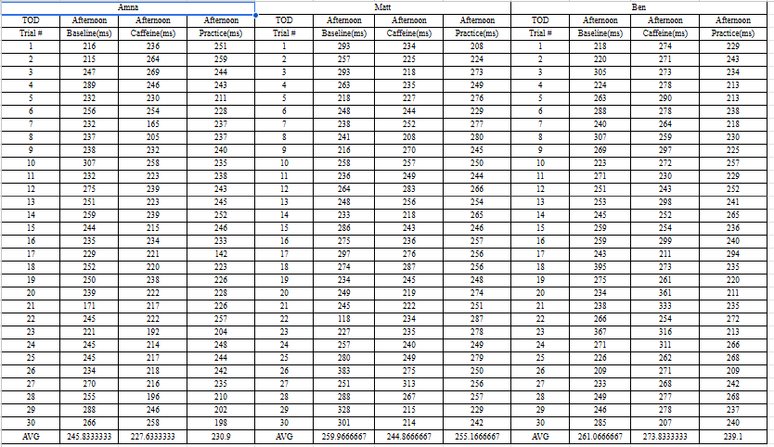
RAW DATA PREVIEW AND DATASET STRUCTURE
Raw reaction time data was collected in Google Sheets
Data included:
  Participant Name
  Trial Number
  Condition
  Time of Day
  Reaction Time (ms)
Raw spreadsheet data was cleaned and converted into a structured dataset using Python.

Slide 4
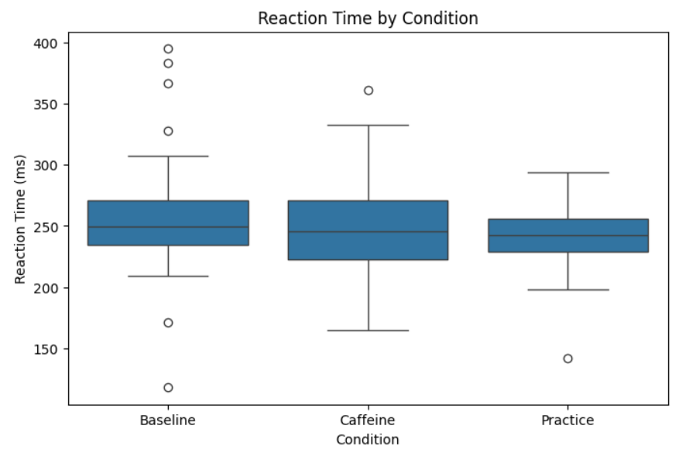

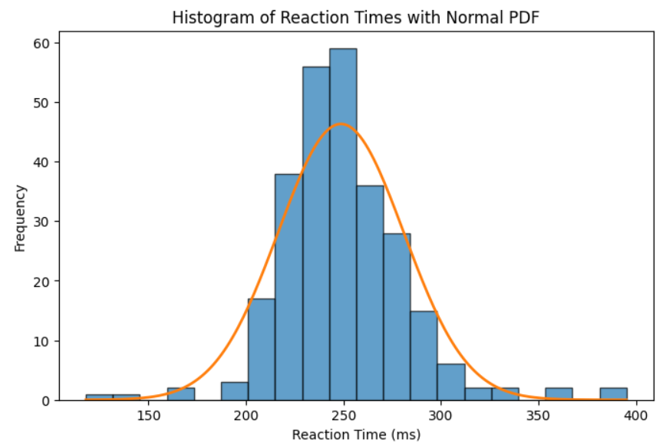
EDA: DISTRIBUTIONS
Practice condition produced the fastest average reaction time
Baseline condition produced the slowest average reaction time
Reaction time data appeared normally distributed
Slight right skewness was observed due to slower outliers
Practice condition had the lowest median reaction time
Outliers were present across all conditions

Slide 5
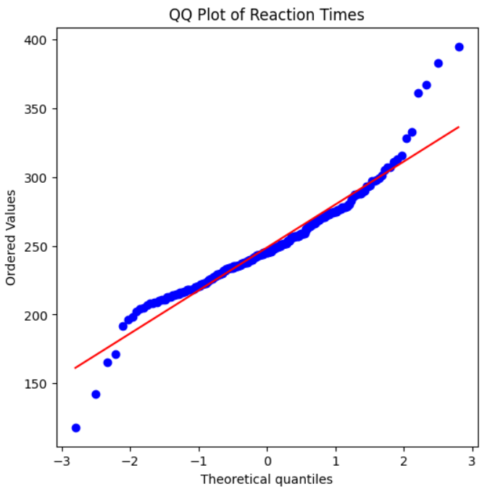
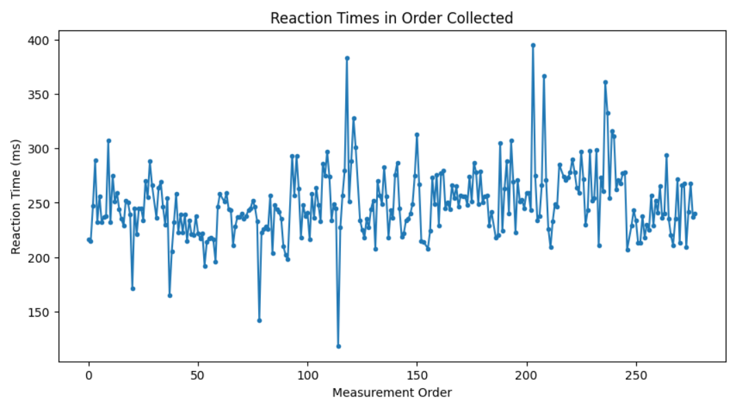
NORMALITY AND TIME SERIES ANALYSIS
QQ plot used to check whether reaction times were approximately normal
Time series plot used to check:
  Drift over time
  Learning effects
  Unusual outliers
Data followed normality reasonably well, with some tail deviations
Reaction times showed natural variation across measurement order
No strong drift trend was observed over time

Slide 6
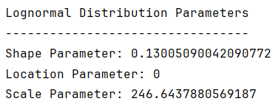
LOGNORMAL DISTRIBUTION FITTING
Reaction time data was:
  Continuous
  Positive
  Slightly right-skewed
A lognormal distribution was selected as the best-fit model
Maximum likelihood estimation (MLE) was used to estimate distribution parameters
The lognormal distribution reasonably matched the observed reaction time data

Slide 7
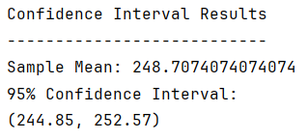
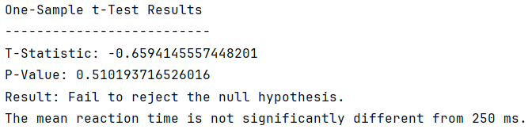
CONFIDENCE INTERVAL AND ONE-SAMPLE T-TEST
A 95% confidence interval for the mean reaction time was calculated using the t-distribution
One-sample hypothesis test performed:
  H₀ : μ = 250 ms
  H₁ : μ ≠ 250 ms
The confidence interval contained 250 ms
The null hypothesis failed to be rejected
Mean reaction time was not significantly different from 250 ms

Slide 8
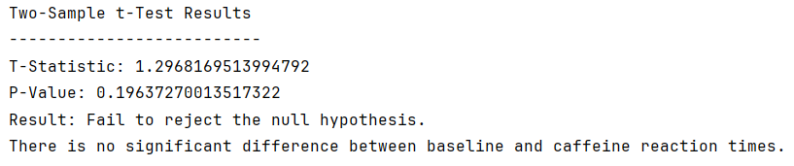
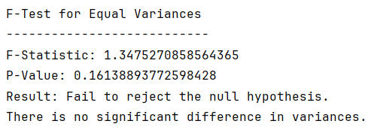
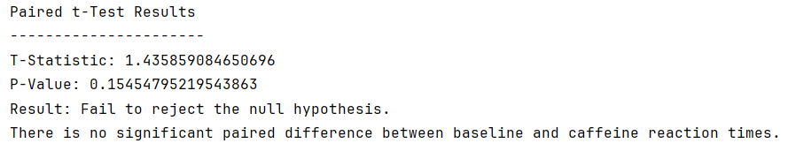
TWO-SAMPLE COMPARISON
Two-sample t-test compared baseline and caffeine reaction times
F-test was used to compare variances between baseline and caffeine conditions
Paired t-test compared matched participant trials
Caffeine showed improvement for some participants, but the overall group effect was not statistically significant.
All test p-values were greater than 0.05

Slide 9
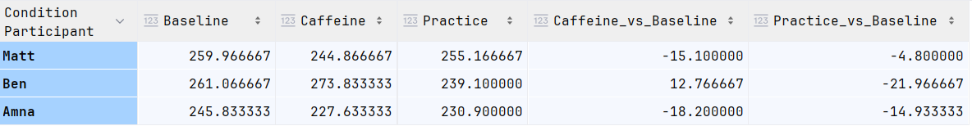
PARTICIPANT-LEVEL RESULTS
Amna and Matt showed improved reaction times under caffeine
Ben showed slower reaction times under caffeine
Practice produced more consistent overall improvement across participants
Individual participant variability affected the overall caffeine results
Negative values indicate faster reaction times
All times are in (ms)

Slide 10
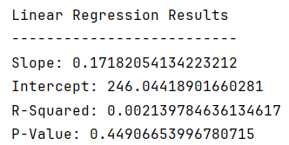
REGRESSION RESULTS
Linear regression was performed using trial number as the predictor variable
Regression results showed a very small R² value
Trial number did not strongly predict reaction time

Slide 11
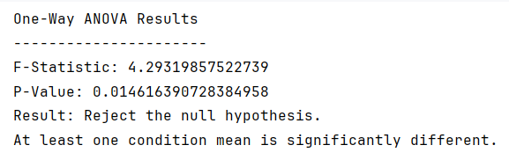
ONE-WAY ANOVA RESULTS
One-way ANOVA compared:
  Baseline
  Caffeine
  Practice
ANOVA results showed at least one condition mean was significantly different
Practice likely contributed most to the significant ANOVA result

Slide 12
CONCLUSIONS
Practice produced the greatest improvement in reaction time
Caffeine effects varied between participants
Reaction time data appeared approximately normally distributed
Practice produced the greatest statistically significant improvement in reaction time
ANOVA results showed statistically significant differences between conditions

Slide 13
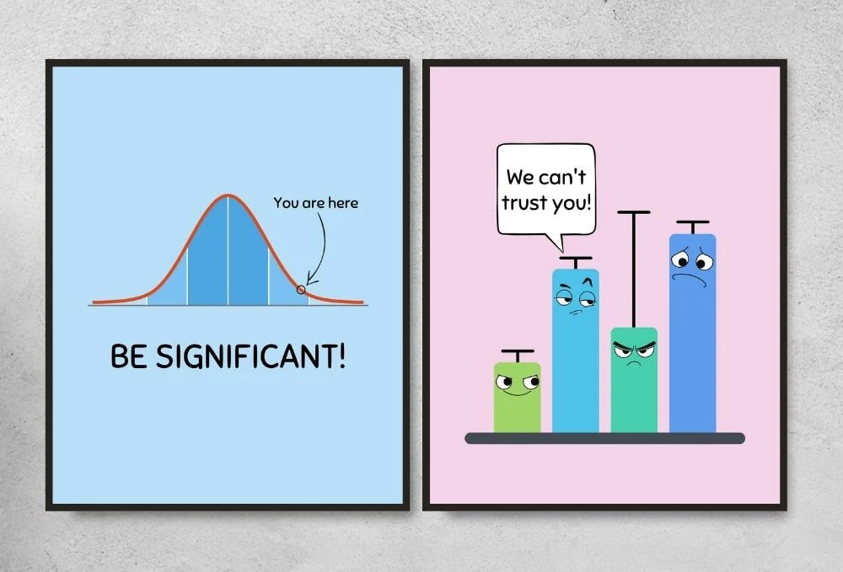
REFERENCES
Human Benchmark Reaction Time Test
  https://humanbenchmark.com/tests/reactiontime
Python
  Used for statistical analysis and data processing
Pandas
  Used for data cleaning and dataset organization
Scipy
  Used for hypothesis testing, confidence intervals, ANOVA, regression, and distribution fitting
Matplotlib
  Used for graph and data visualization creation
Seaborn
  Used for statistical plotting and box plot generation
Jupyter Notebook
  Used to develop and document the statistical analysis workflow

